Slide 1
E-Commerce website

Slide 2
INTRODUCTION
E-commerce (electronic commerce) is the activity of electronically buying or selling of products on online services or over the Internet. Electronic commerce draws on technologies such as mobile commerce, electronic funds transfer, supply chain management, Internet marketing, online transaction processing, electronic data interchange (EDI), inventory management systems, and automated data collection systems. E-commerce is in turn driven by the technological advances of the semiconductor industry, and is the largest sector of the electronics industry.
Modern electronic commerce typically uses the World Wide Web for at least one part of the transaction's life cycle although it may also use other technologies such as e-mail. Typical e-commerce transactions include the purchase of online books (such as Amazon) and music purchases (music download in the form of digital distribution such as iTunes Store), and to a less extent, customized/personalized online liquor store inventory services. There are three areas of e-commerce: online retailing, electronic markets, and online auctions. E-commerce is supported by electronic business.

Slide 3
HARDWARE AND SOFTWARE REQUIREMENT
Hardware Requirement :-
Minimum 4 GB RAM
Atleast 2 GB Hard Disk
Pentium 4 Processor and onwards
Screen resolution- 600 x 800
Software Requirement:-
Windows XP, 7, 8, 10
Oracle (My SQL) / SQLite3
Reason:-
It Facilitates in Handling queries & Helping developing good data base design
Programming Languages:-
Python
HTML 5

Slide 4
E-commerce businesses may also employ some or all of the followings:
Online shopping for retail sales direct to consumers via Web sites and mobile apps, and conversational commerce via live chat, chatbots, and voice assistants.
Providing or participating in online marketplaces, which process third-party business-to-consumer (B2C) or consumer-to-consumer (C2C) sales.
Business-to-business (B2B) buying and selling.
Gathering and using demographic data through web contacts and social media.
Business-to-business (B2B) electronic data interchange.
Marketing to prospective and established customers by e-mail or fax (for example, with newsletters).
Online financial exchanges for currency exchanges or trading purposes

Slide 5


Slide 6
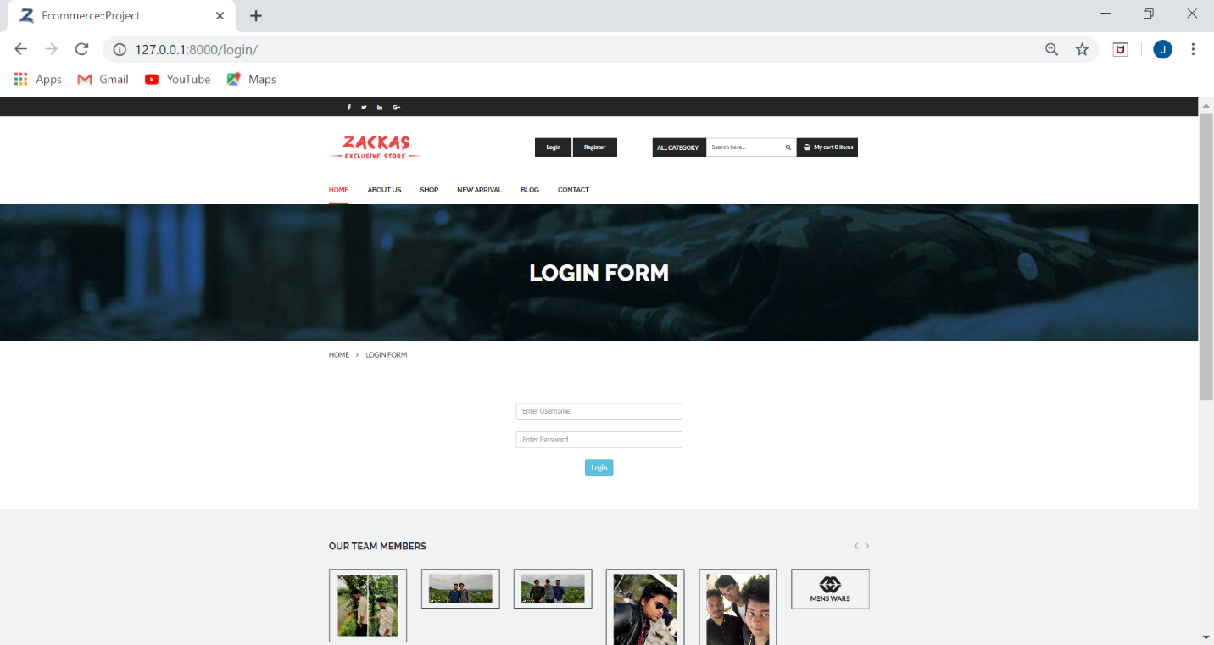

Slide 7
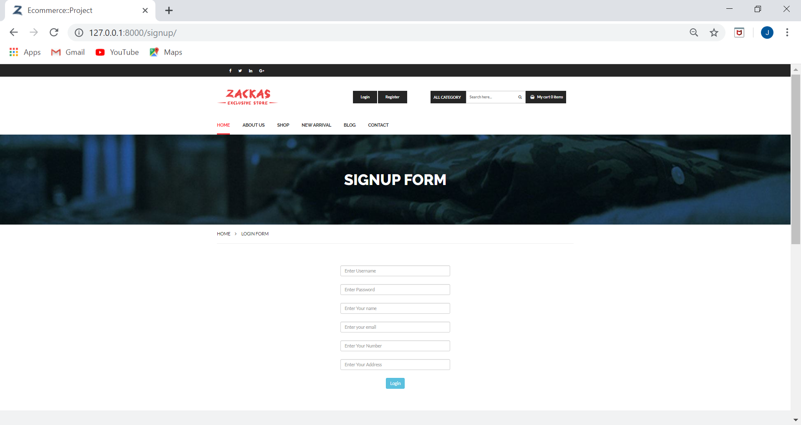

Slide 8
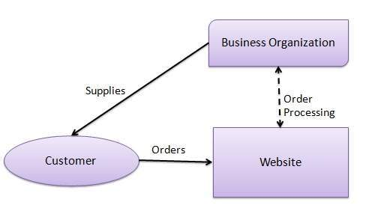
BLOCK DIAGRAM

Slide 9
FUTURE ENHANCEMENT
We can secure the payment gateway in this website.
We can change the database from sqlite3 to SQL so that it enhances the security.
We can upgrade the payment methods on this website as we are buying products through online payment currently.
We are going to provide more products on this website for the users.
We make sure that this website is also available for all OS platforms.

Slide 10
LIMITATION
Security: One of the main limitations of e-Commerce is security. In most cases, people are hesitant to provide their personal and financial details in spite of advanced data encryption security systems in place.
Huge Technological Cost: A lot of money needs to be invested to be built up the technical infrastructure needed to run an e-Commerce business.
COD is not available: Order can only placed with online transaction.
No return policy.
Windows Based Website: The following website is only applicable for Windows

Slide 11
SUBMITTED BY:-
JAY PATHAK
PRASHUK JAIN
RITESH KUMAR

Slide 12
THANK YOU

